Slide 1
Computational Neuroscience: Systems Neuroscience in the Context of the Hippocampus
Heath Robinson, Ph.D
CWRU Undergraduate Neuroscience

Slide 2
Objectives
Understand the different methodologies used to record the brain in vivo
Understand the differences between EEG, ECoG, and LFP
Understand the physiology of place cells fire and reactivation during SWRs
Understand the importance of cell assemblies

Slide 3
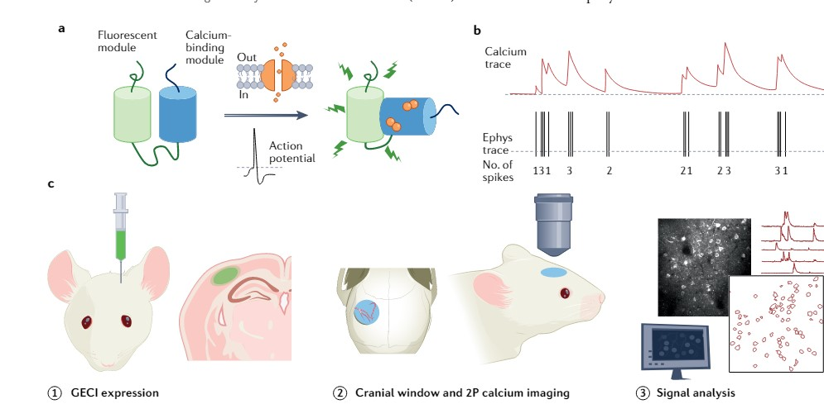
Techniques in Systems Neuroscience – Single cell recording – Calcium transients from Calcium Imaging
Grienberger…Portera-Callilau Nature Reviews Method Primer 2022

Slide 4
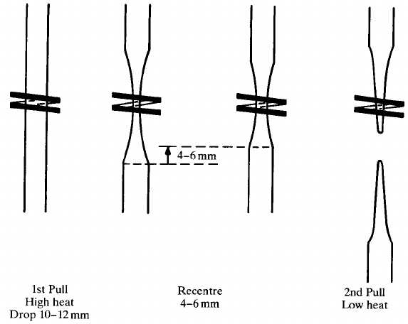
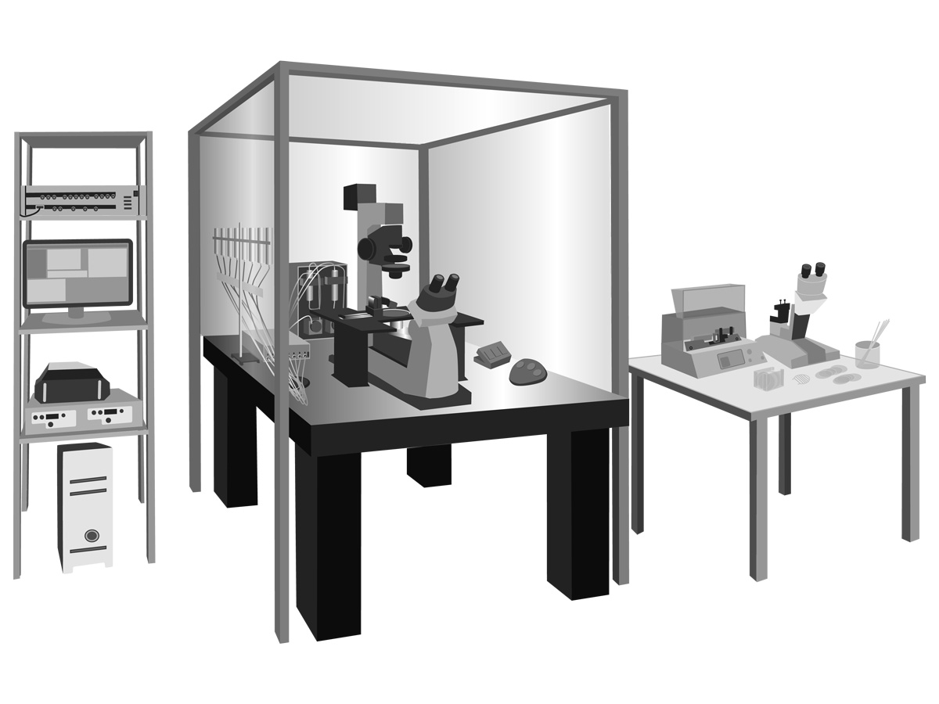
Techniques in Systems Neuroscience – Single cell recording – Patch Clamp
Ogden and Stanfield.(1994) Patch clamp techniques for single channel and whole-cell recording.

Slide 5
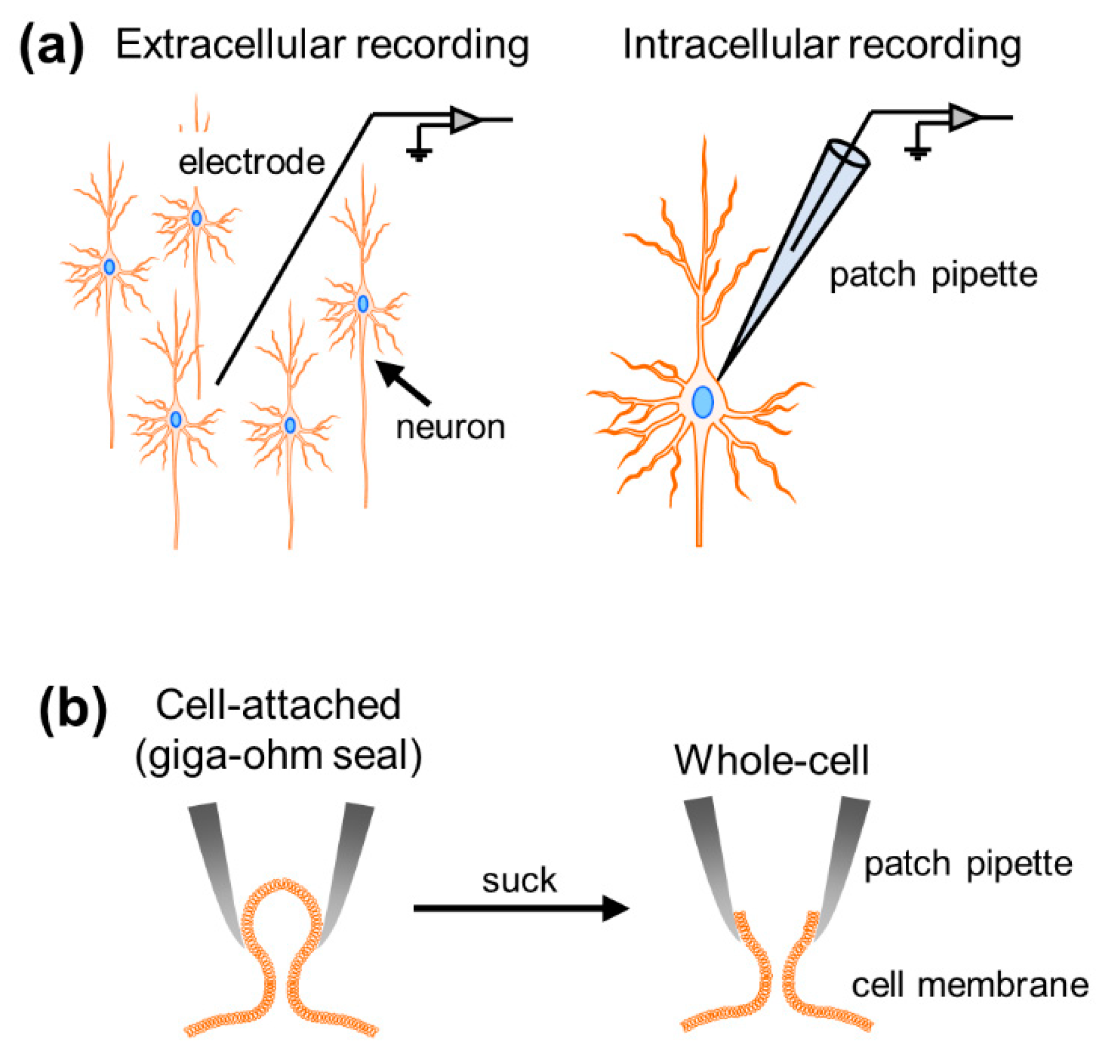

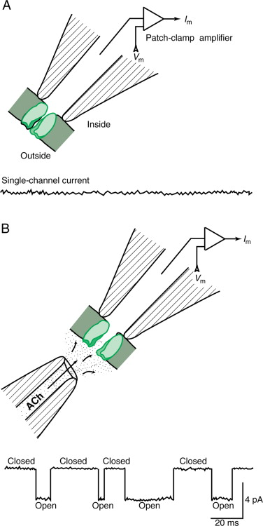
Slice In Vitro Electrophysiology
Wikipedia

Slide 6
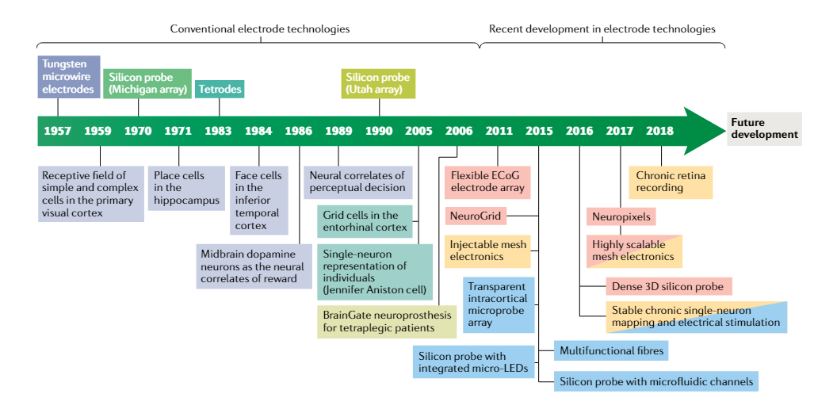
Techniques in Systems Neuroscience – Single cell recording – Tetrodes and Silicon Probes
Hong and Lieber Nature Reviews Neuroscience 2019

Slide 7
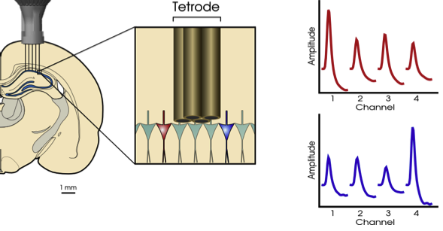
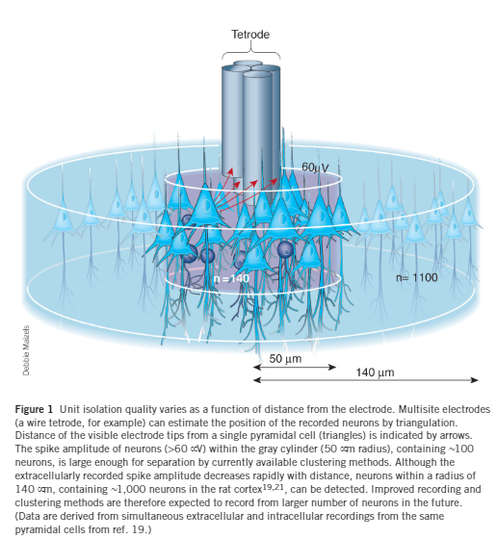
Techniques in Systems Neuroscience – Single cell recording – Tetrodes and Spike Sorting
Wikipedia
Buzsaki Nature Neuroscience 2004

Slide 8
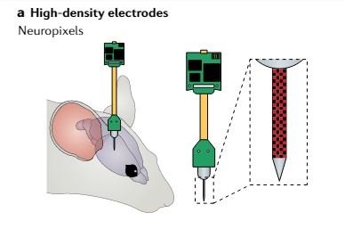
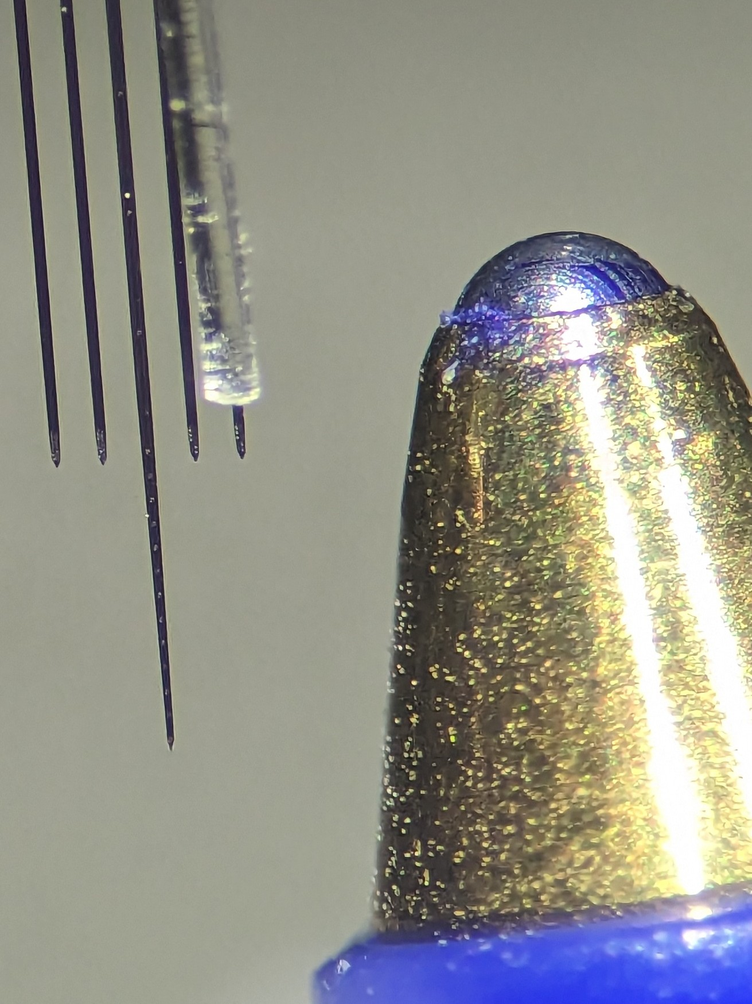
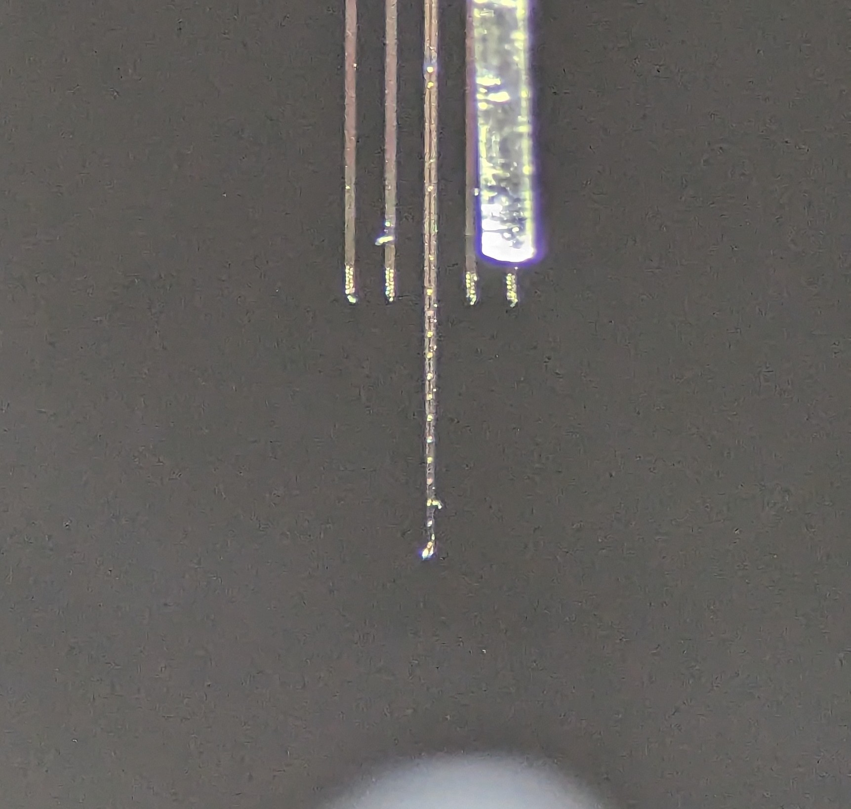
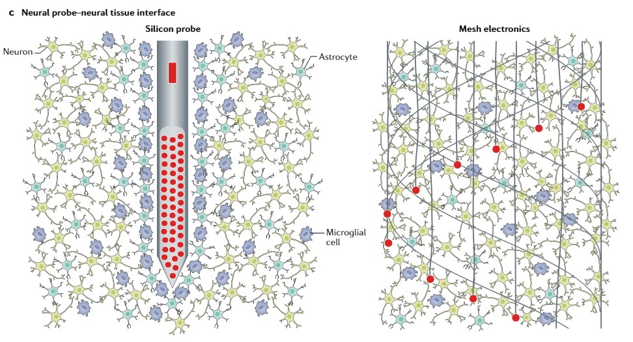
Techniques in Systems Neuroscience – Single cell recording – Tetrodes and Silicon Probes
Hong and Lieber Nature Reviews Neuroscience 2019

Slide 9
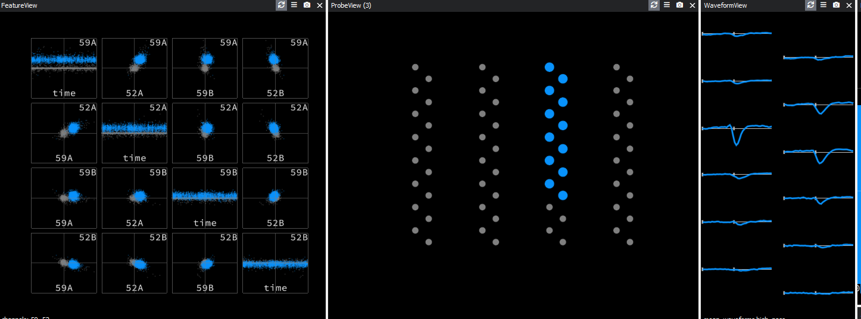
Techniques in Systems Neuroscience – Single cell recording – Tetrodes and Silicon Probes

Slide 10
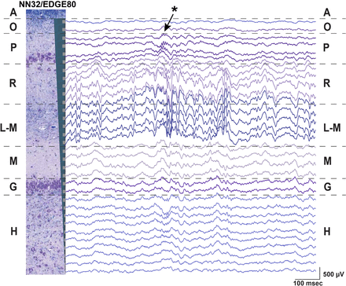
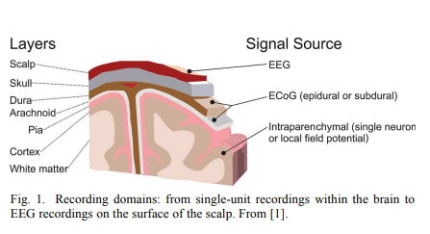
Techniques in Systems Neuroscience – Single cell recording – EEG, ECoG, LFP and Laminar Recordings
Ulyanova et al. Frontiers in Neuroscience 2019
Schalk and Leuthardt IEEE Reviews in Biomedical Engineering 2011

Slide 11
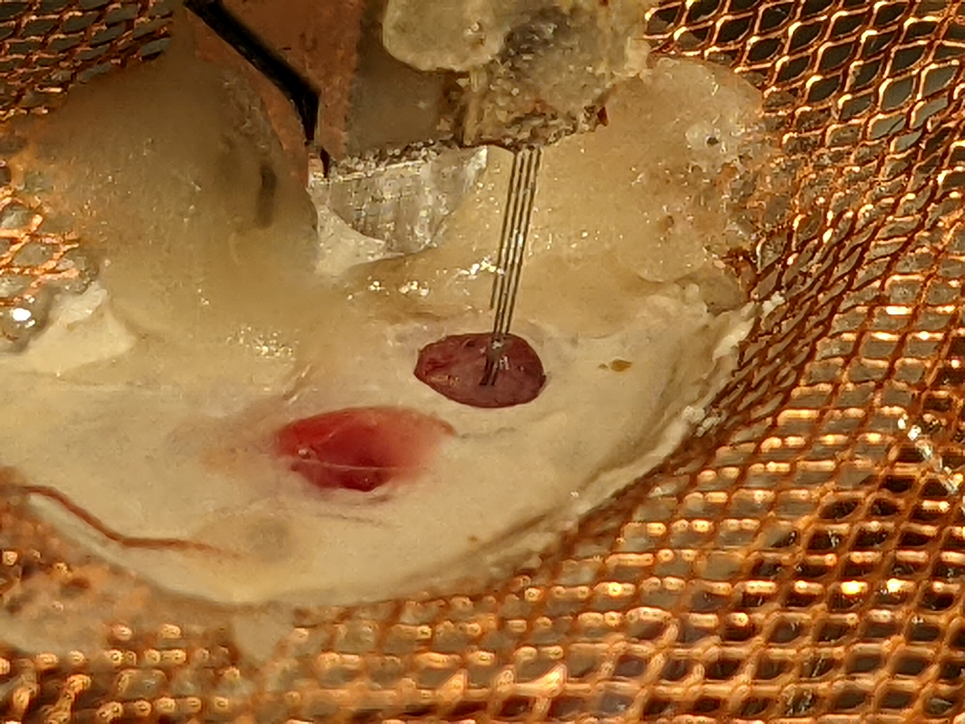
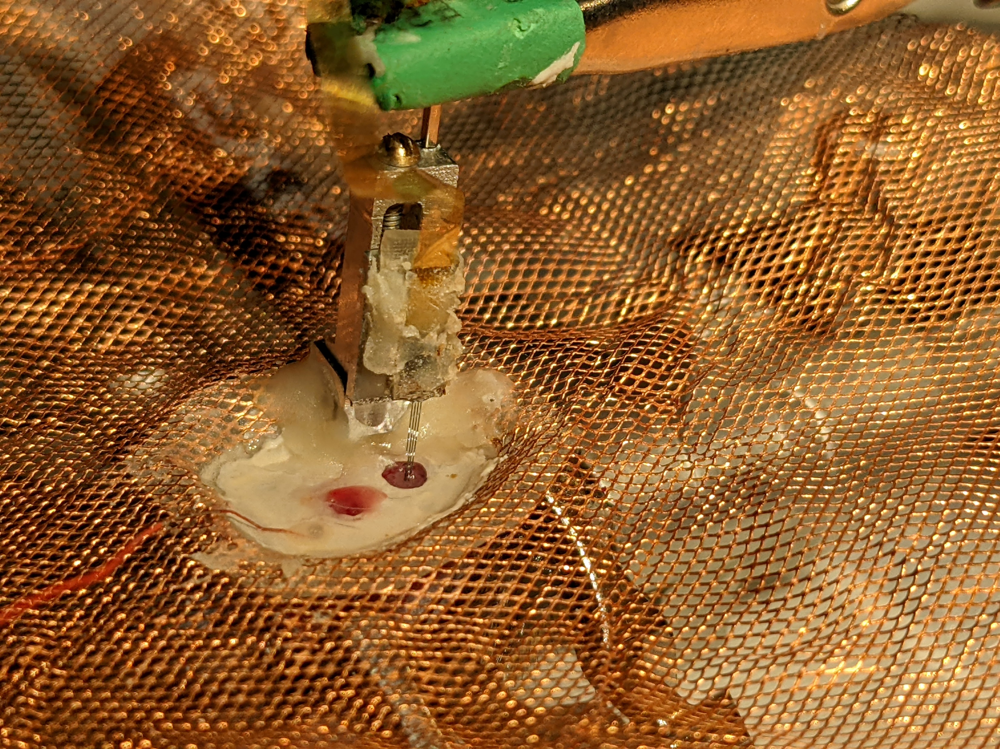
Techniques in Systems Neuroscience – Single cell recording – Silicon Probes

Slide 12
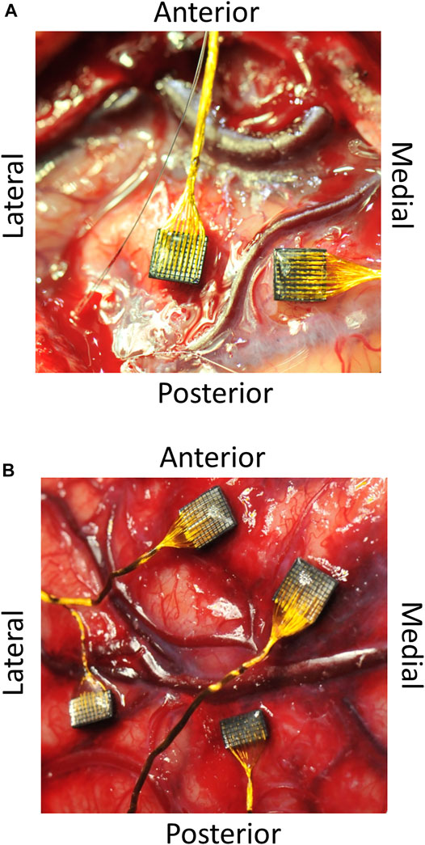
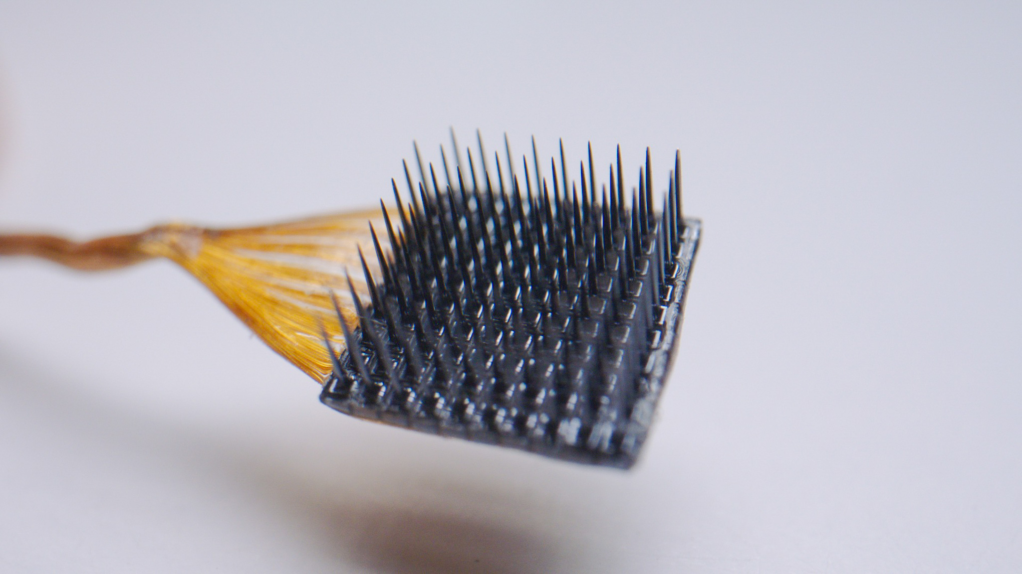
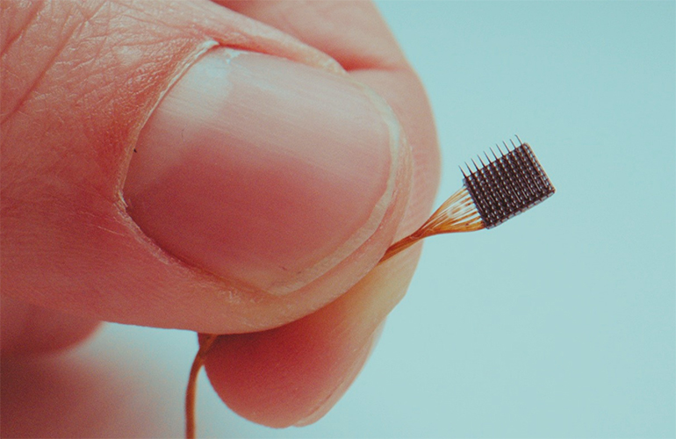
Techniques in Systems Neuroscience – Single cell recording – Utah Array

Slide 13
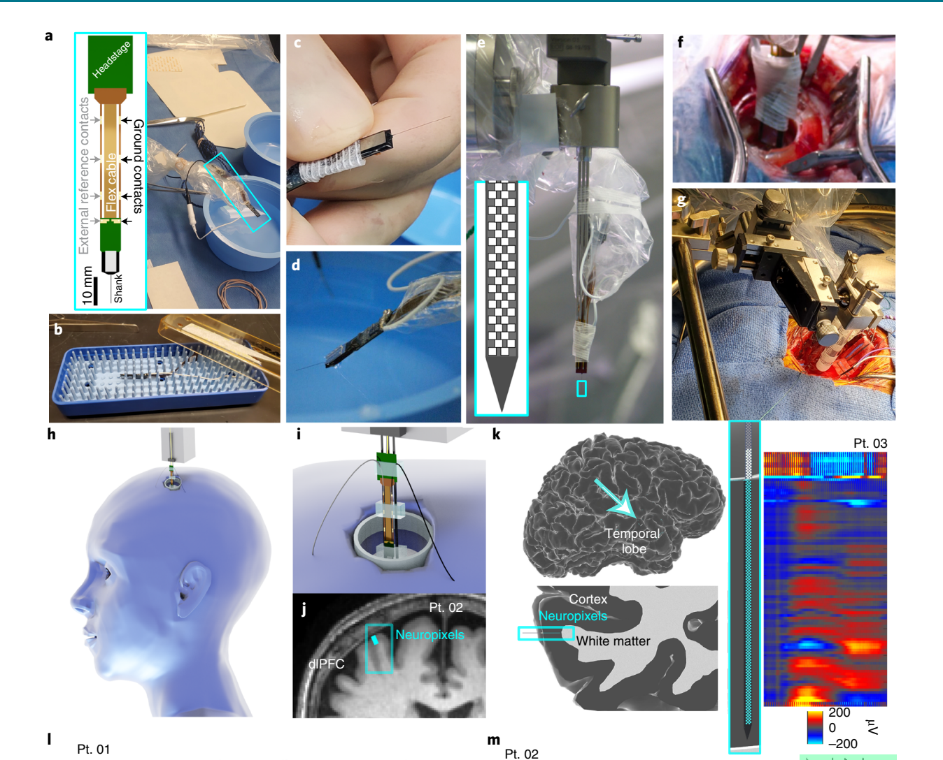
Techniques in Systems Neuroscience – Utah Array versus Silicon Probes
Paul et al. Nature Neurosciencei 2022c

Slide 14
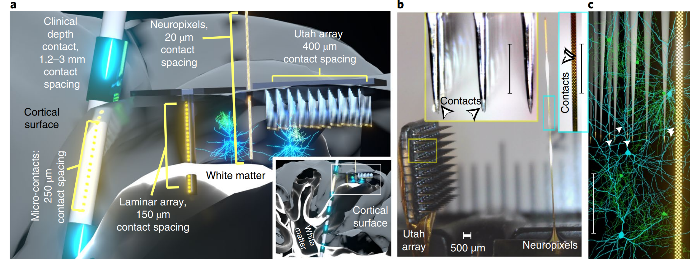
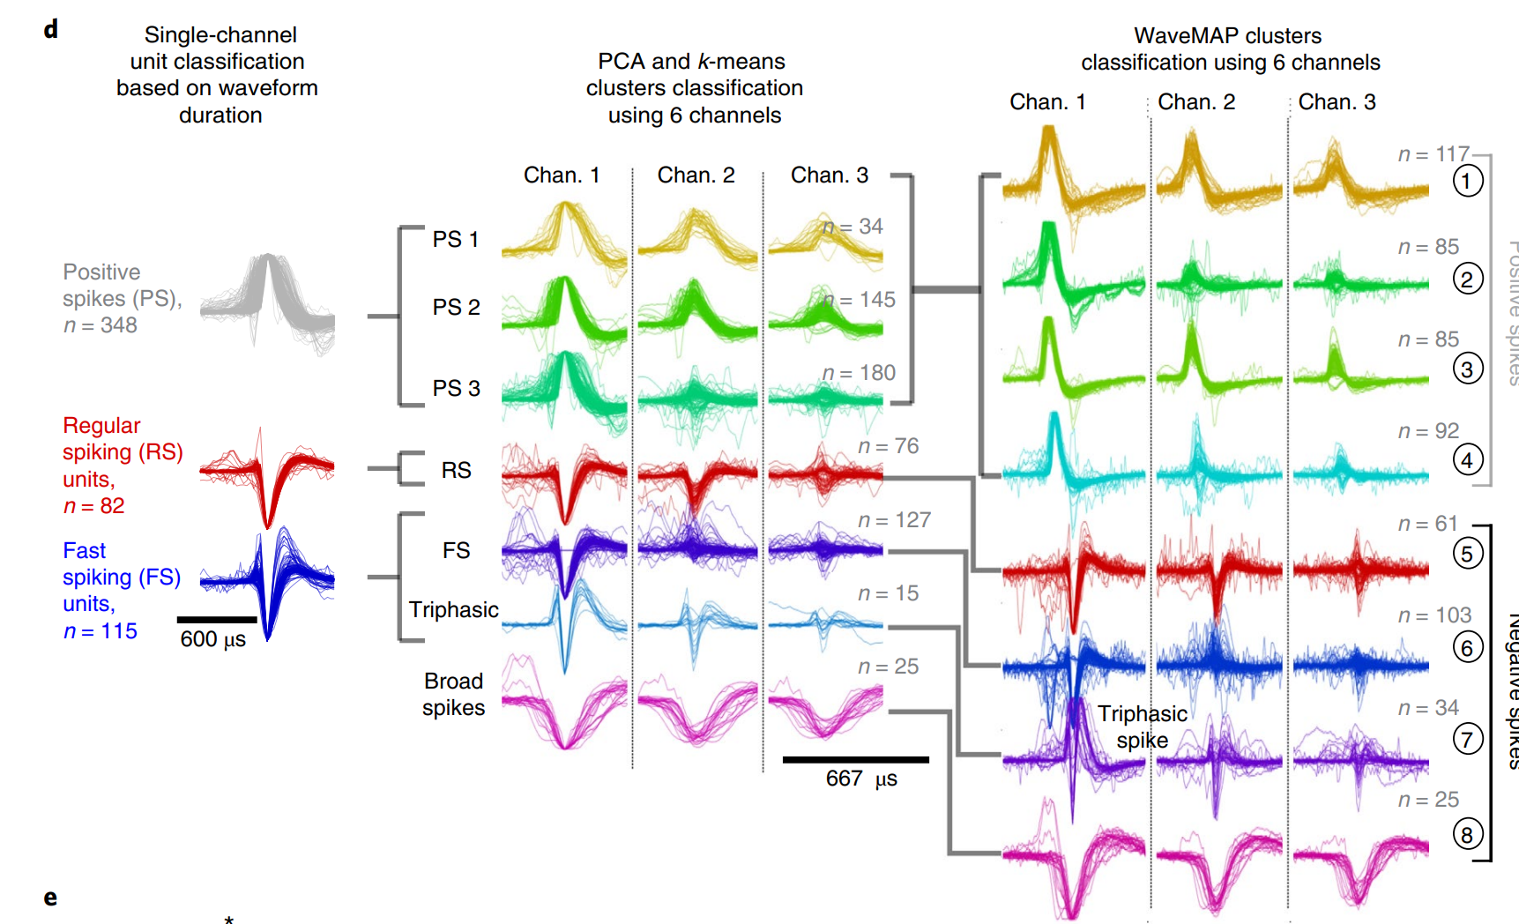
Techniques in Systems Neuroscience – Utah Array versus Silicon Probes
Schalk and Leuthardt IEEE Reviews in Biomedical Engineering 2011

Slide 15
So, what are we recording? And how do we make sense of it?

Slide 16
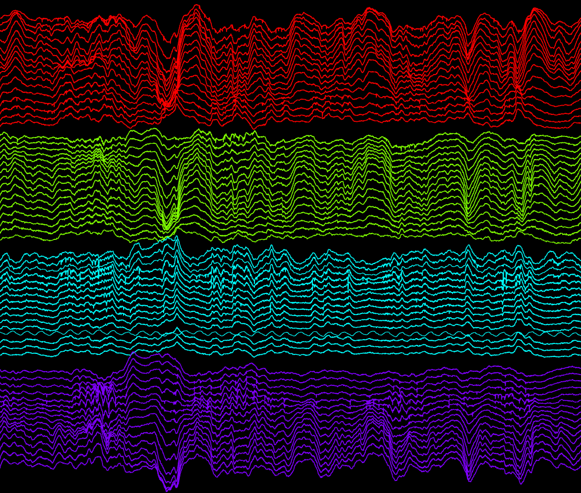
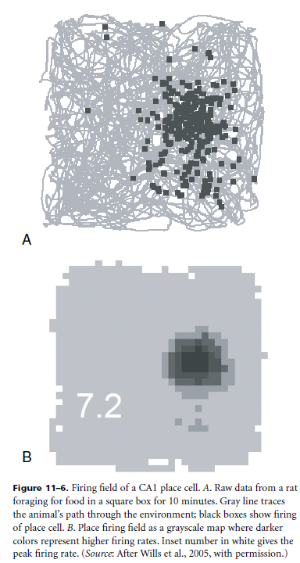
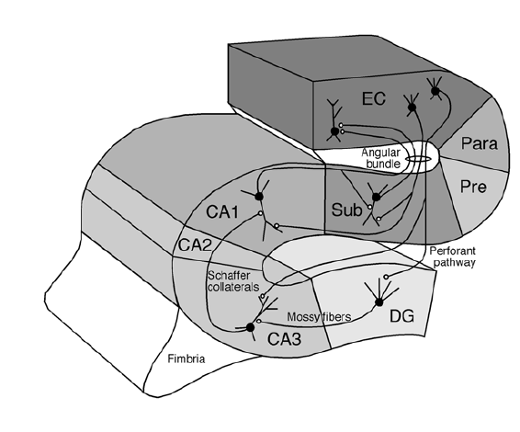
Techniques in Systems Neuroscience – Single cell recording – Hippocampus sleep recording
Andersen et al. The Hippocampus Book 2007. Oxford University Press

Slide 17
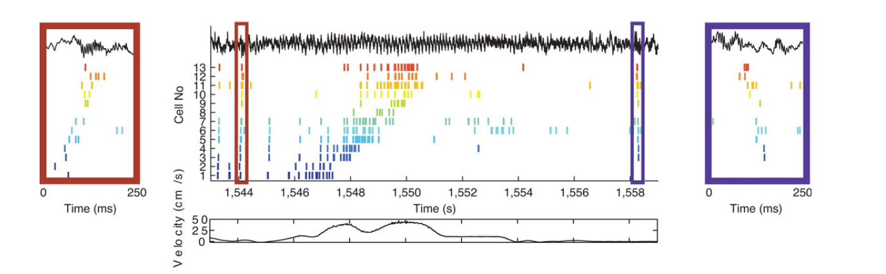
Hippocampus Place Cell Progression through a Linear Maze – rate coding
Diba and Buzsáki Nature Neuroscience 2007

Slide 18
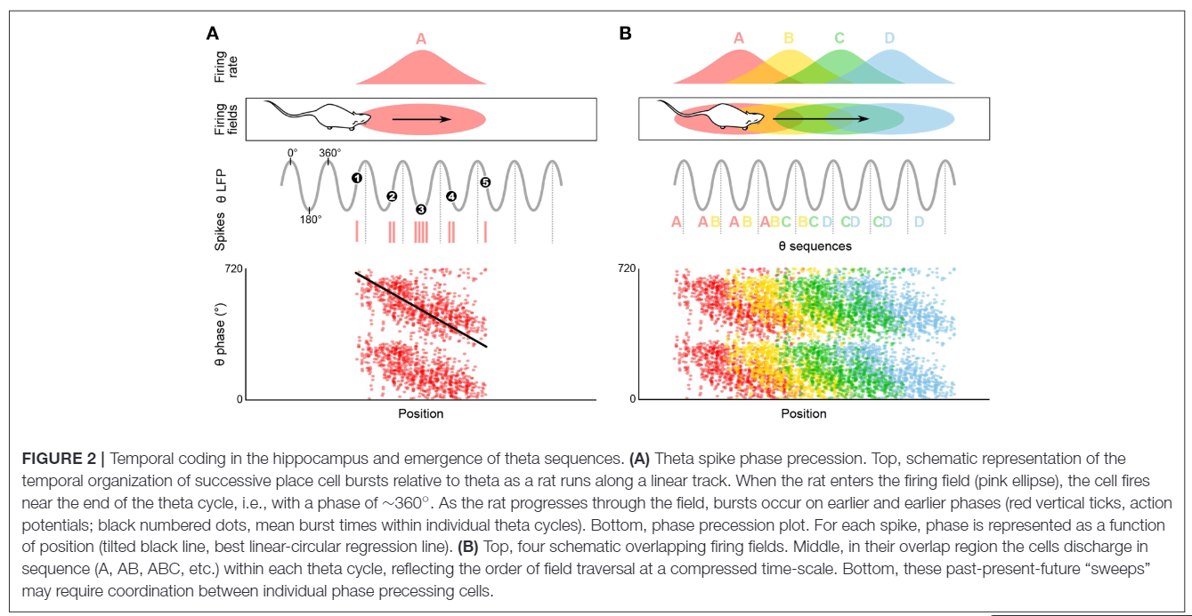
Hippocampus Place Cell Progression through a Linear Maze – temporal coding (ie Phase Procession)
Drieu and Zugaro Frontiers in Cellular Neuroscience 2019

Slide 19
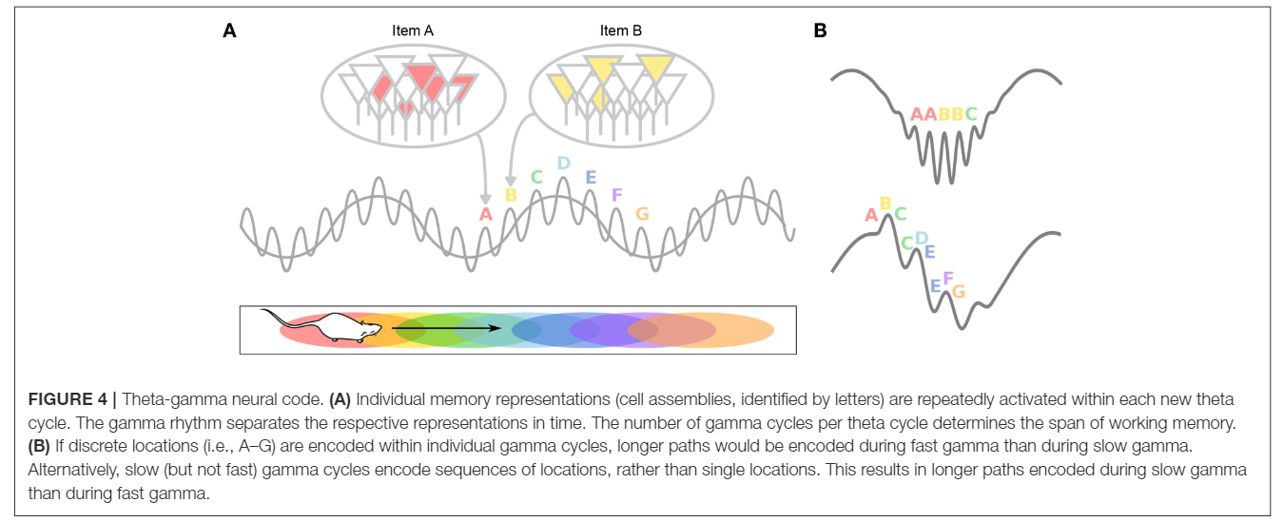
Hippocampus Place Cell Progression through a Linear Maze – temporal coding (ie Phase Procession)
Drieu and Zugaro Frontiers in Cellular Neuroscience 2019

Slide 20
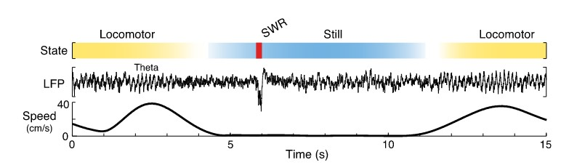
Hippocampus States – Theta and SWRs
Kay and Frank Hippocampus 2019
Diba and Buzsáki Nature Neuroscience 2007

Slide 21
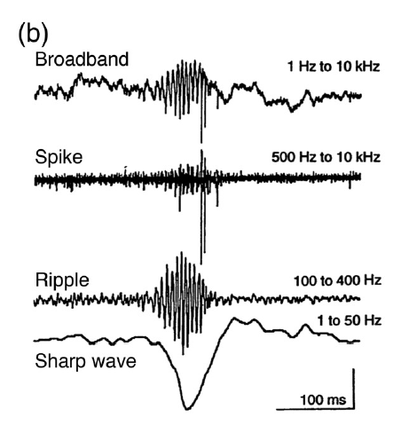
Sharp-wave ripples (SW-R) – High Frequency Event Hippocampus Place Cell Progression through a Linear Maze – Sharp Wave Ripples reactivation state during Immobility
Pyramidal Neurons
Buzsáki and Chobrak Nat. Neuroscience 2005
Buzsáki Progress in Neurobiology 1984
Buzsáki Brain Research 1986
Buzsáki…Wise Science 1992

Slide 22
Hippocampus Place Cell Progression through a Linear Maze – Sharp Wave Ripples reactivate place cells d
Diba and Buzsáki Nature Neuroscience 2007

Slide 23
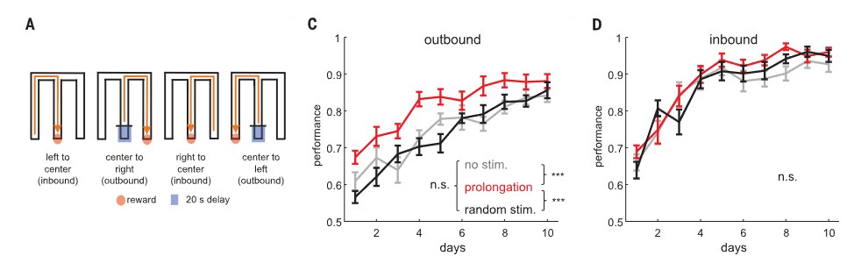
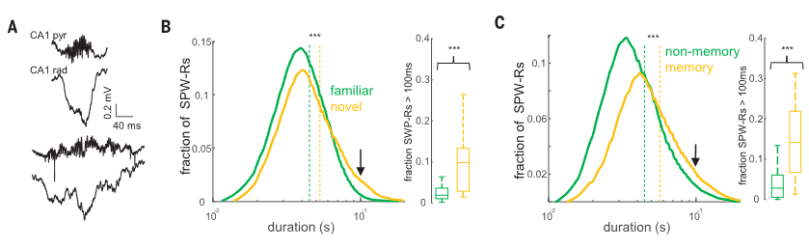
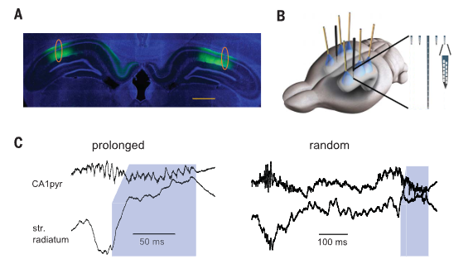
Increasing the Length of Awake SWRs Artificially Increases Spatial Memory
Fernandez-Ruiz, Oliva Science 2017

Slide 24
Hippocampus States – Theta and SWRs
Kay and Frank Hippocampus 2019
Diba and Buzsáki Nature Neuroscience 2007

Slide 25
Impairing Sleep SWRs Impairs Spatial Memory
Girardeau...Zugaro Nat. Neuroscience2009

Slide 26

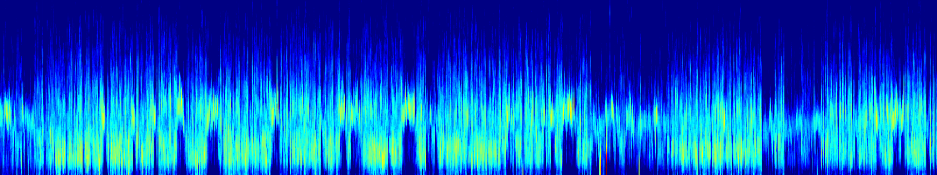
-20
Sleep States – Wake, REM, NREM
20
Power (dB)
Hippocampus LFP
15
-40
Frequency (HZ)
10
5
0
NREM
REM
Wake
EMG
0.5 mV
NREM
500 s
LFP
EMG
REM
LFP
EMG
Wake
LFP
EMG
0.5 mV
1 s
Robinson et al.The Journal of Neuroscience 2021
Notes:
Wake 108 128
Nrem 5280 5290
Rem 3280 3290

Slide 27
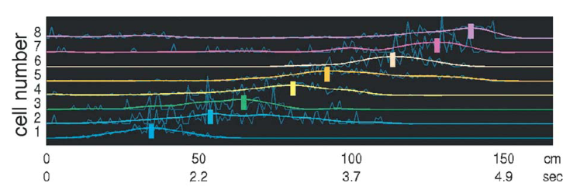
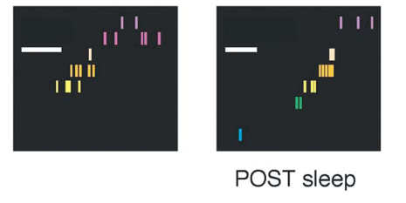
Sleep SWRs Reactivate Trajectories from Previous Experience
RUN
Lee and Wilson Neuron 2002

Slide 28
Two stage Model of Memory in Hippocampus – Encode, then Consolidate
1. Encoding
2. Consolidation

Slide 29
How does the brain-firing activity present itself?

Slide 30
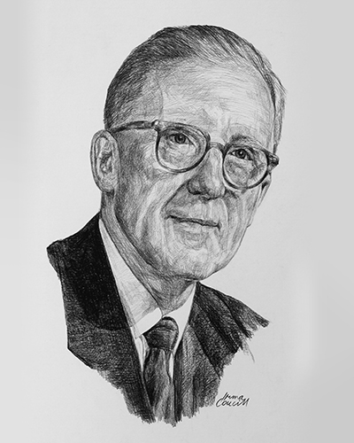
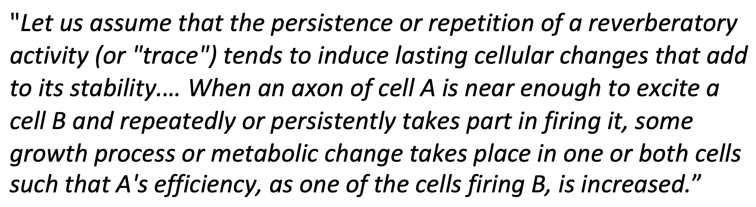
How Does the Brain Present Neural Patterns – Groups of Assemblies and Hebbian Plasticity
-Donald Hebb The Organization of Behiavor: A Neuropsychological Theory. 1949
“Neurons that fire together wire together”

Slide 31
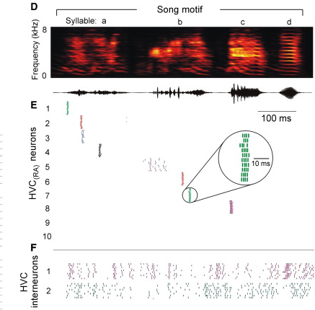
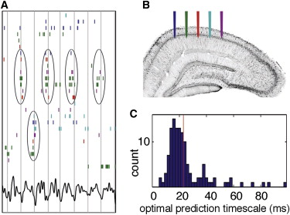
How Does the Brain Present Neural Patterns – Groups of Assemblies and Hebbian Plasticity
Buzsáki Neuron 2010
Hahnloser, Kozhevnikov, Fee Nature 2002
Harris… Buzsáki Nature 2003

Slide 32
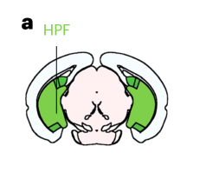
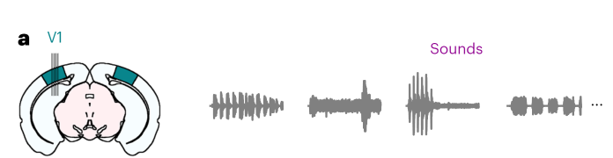
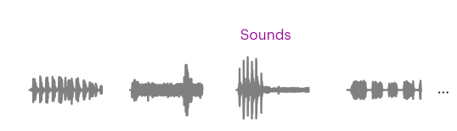
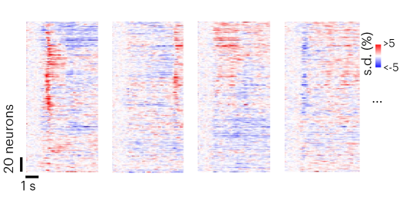
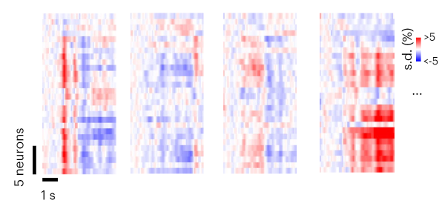
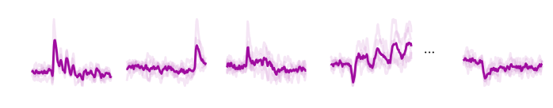
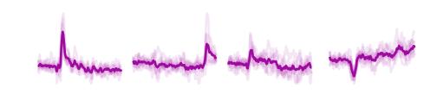
How Does the Brain Present Neural Patterns – Groups of Assemblies and Hebbian Plasticity
Bimbard et al. Nature Neuroscience 2023

Slide 33

The current state of Neuroscience – Understanding the Neurophysiology Underlying Behavior
"The problem of understanding behavior is the problem of understanding the total action of the nervous system, and vice versa.
This has not always been a welcome proposition, either to psychologist or to physiologist"
-D.O. Hebb
From Netflix “Birds of Paradise”

Slide 35
Thanks!

Slide 36
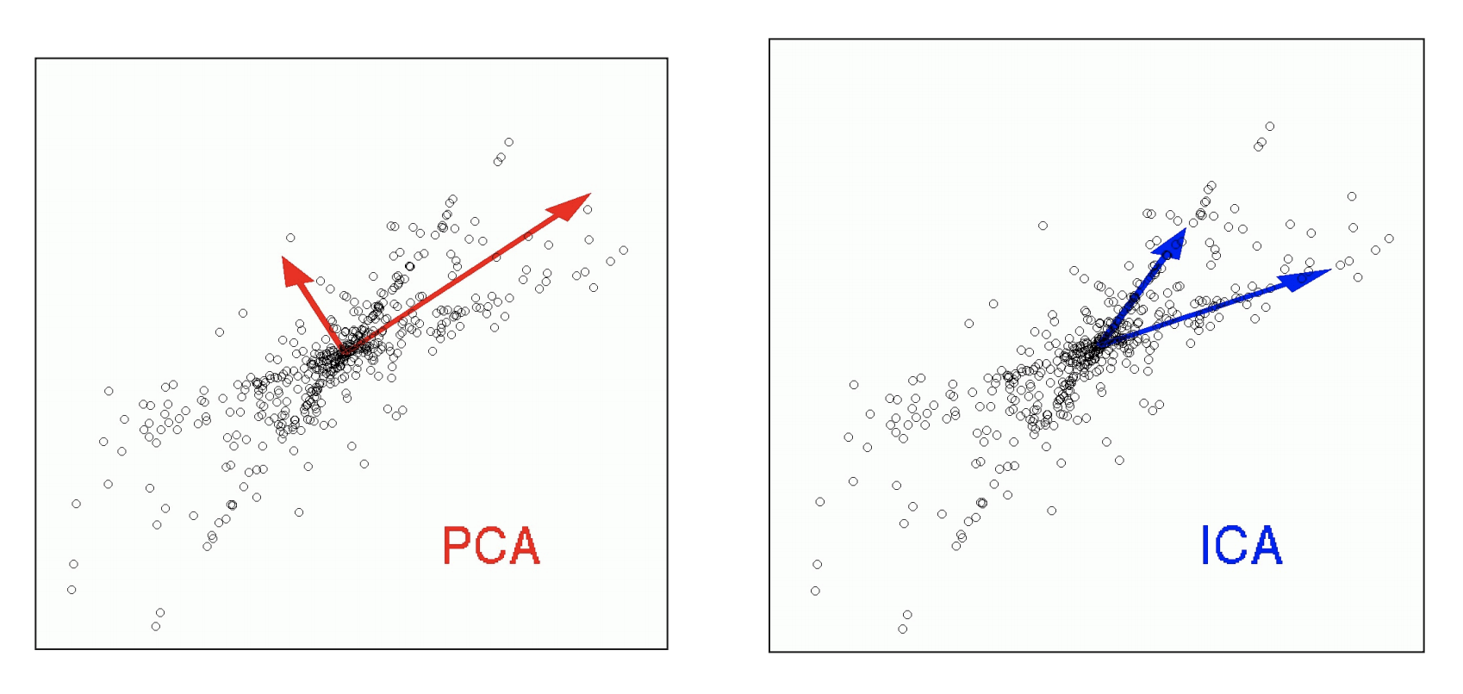
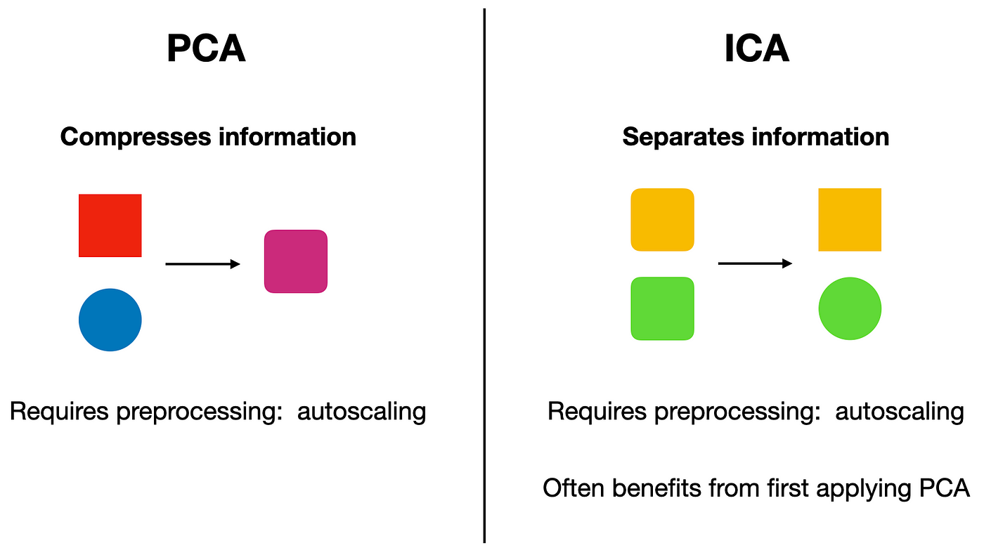
Independent Component Analysis
Bonus - Neuron Cell Assembly Detection

Slide 37



Bonus - Neuron Cell Assembly Detection
Correlation Matrix
ICA to determine the contribution (i.e. weight) of a neuron to each assembly (component)
Bin and Z Score Spikes
Project the Weight Matrix back onto the z-score binned data = Assembly Activity of each assembly over time
PCA and Determination of components (Marchenko -Pastur law)
Lopes-dos-Santos, Ribeiro and Tort The Journal of Neuroscience Methods 2013

Slide 38


Bonus - Neuron Cell Assembly Detection
Van de Ven…Dupret Neuron 2016

